Slide 1
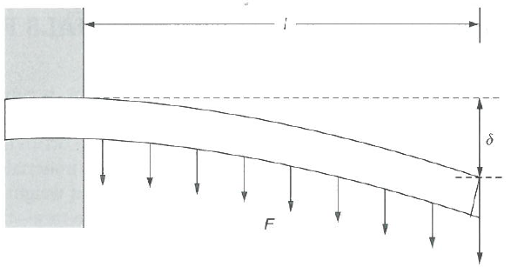
Light Alloys: Mast on a yacht
Function: Carrying load imposed by the boom and the mainsail
Objectives: Carries approximately uniform loading imposed by the mainsail, must be as light as possible while maintaining mechanical performance, must minimise mass
Constraints: must be mass produced, low production costs, resists elastic bending, corrosion resistant, length and radius of the mast are fixed by the design, must have toughness
Free variable: Choice of material, wall thickness
L
Simplified case: cantilever beam subjected to uniformly distributed loading
But here we have the additional constraint that it must resist elastic bending. The cross-section of the mast is essentially a thin walled tube of radius r and wall thickness t and length L.

Slide 2
Mast on a yacht
The bending deflection can be given as δ = (1/8) (FL³/EI)
The secondary moment of area is I = πr³t
Combining these two equations, the bending stiffness of the tube is
F/δ = 8πEr³t/L³
For a thin wall the mass of the beam is given by
m = 2πrtLρ
Therefore
m=L⁴Fρ/(4r²δE)
The mass of tube for a specified bending stiffness is therefore minimised by (1/m). Thus selecting a material with the maximum value of the performance index
M = E/ρ

Slide 3
Mast on a yacht
Merit index: M = E/ρ
This merit index is commonly used for minimum weight design of stiff ties, beams, shafts; minimum deflection in centrifugal loading, etc.
Taking logs then
log M = log E - log ρ
Thus
log E = log ρ + log M
Which is the form y = mx + c
Therefore plot log E versus log ρ and lines with slope 1 will have the same merit index. To minimise mass, maximise merit index M.

Slide 4
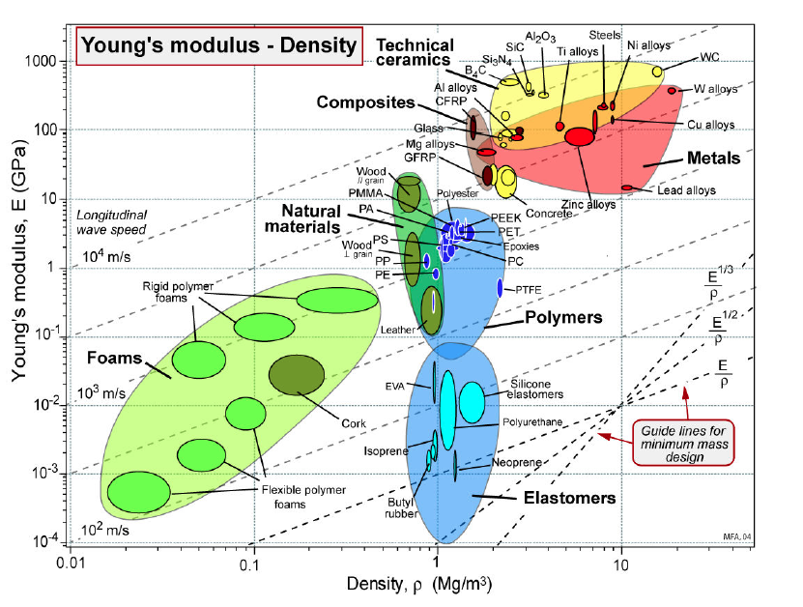
Materials Selection
Notes:
Comments:
Since 1960s, Al alloys have been widely used for masts for sailing ships.
Steels are not suitable because of corrosion problems in thin sections.
Ti alloys are expensive.
But CFRP gives a dramatic improvement as seen from the graph, but it is not used extensively because is 30 times more expensive than Al alloys. Unless for racing yachts. Also danger swhen it does fracture

Slide 5
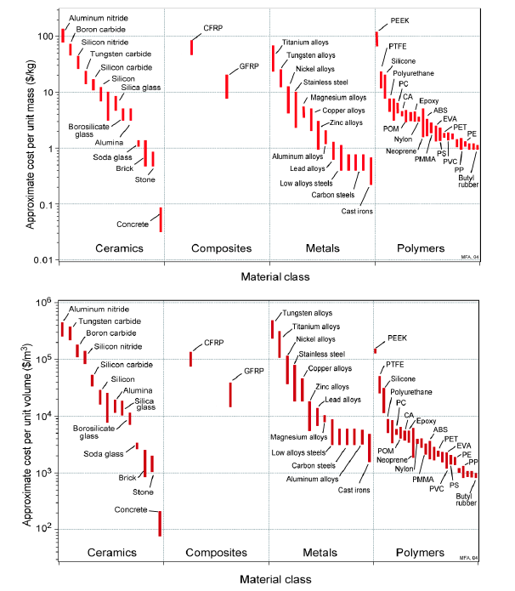

Slide 6
Mast summary
Thus we have used the merit index E/ρ plus other factors such as toughness and cost to select Aluminium Alloys. The specific Al alloy series is selected based on other factors such as strength, corrosion resistance and fabrication method, in this case ease of extrusion.
See Light Alloys Question 5 to explore the different Al alloy series:
Link: Another example of extrusion….

Slide 7
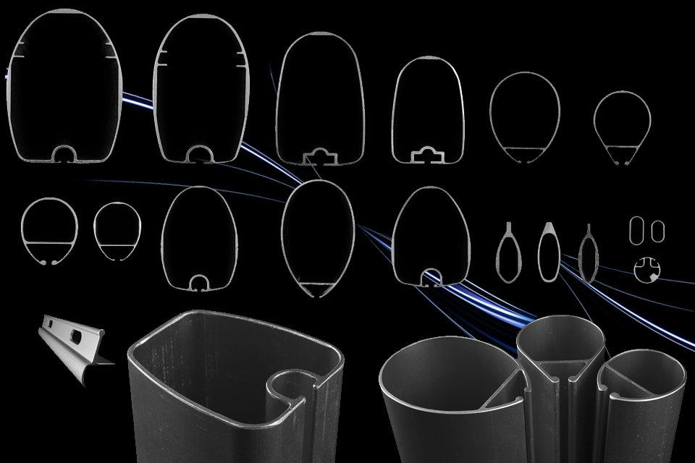
Can be extruded into complex shapes
Thus aluminium alloys have a high SHAPE FACTOR. Shape factor can be used in materials selection as shown in Block C.

Slide 8
Al alloys materials selection
So which of the many Aluminium alloys from the 1000, 2000, 3000, 4000, 5000 ,6000, 7000… series should you choose for a particular application.
 | Principle alloying element
1xxx | 99.000% Minimum Aluminum
2xxx | Copper
3xxx | Manganese
4xxx | Silicon
5xxx | Magnesium
6xxx | Magnesium and Silicon
7xxx | Zinc
Now do Light Alloys Q5 which requires you to read the handout on the Al alloy series

